Slide 1
Weight Loss
How To Inject Semaglutide, Terzepitide, and other Weight Loss Medications

Slide 2
Semaglutide Injection Steps

Slide 4
Step 1: Assemble your supplies
You will need your medication vial, one syringe, and an alcohol swab.

Slide 5
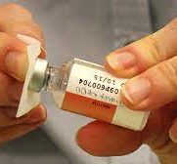
Step 2: Wash hands & prepare injection site
Clean the injection site and the top of the vial with the alcohol swab. Let the skin dry.

Slide 6
•A. Remove the seal on the top of the vial (if it has one) and wipe with alcohol.
•B. Remove the orange cap off the needle.
•C. Hold the syringe like you hold a pen or a dart, inserting the needle into the middle of the rubber stopper perpendicular, so the needle does not bend.
•D. Together, turn the vial and syringe upside down.
•E. Make sure the tip of the needle is in the liquid.
•F. Pull the plunger down, past the dosage prescribed. Then, push the plunger up to the prescribed dosage, as this will remove all air bubbles.
•G. Once you have the correct amount of medicine, pull the entire syringe out of the vial.

Slide 7
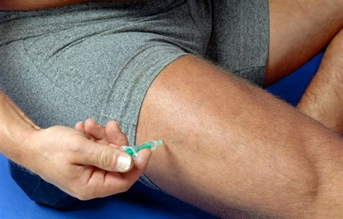
Step 4: Subcutaneous Injection
Subcutaneous injections will cause very little pain because the medication is injected directly under the skin. Please remember the medication may be injected into the stomach, thighs, and back of the upper arm.
Always check your medication to ensure it is clear and colorless, if it is cloudy, discolored, or contains particulates contact your provider.

Slide 9
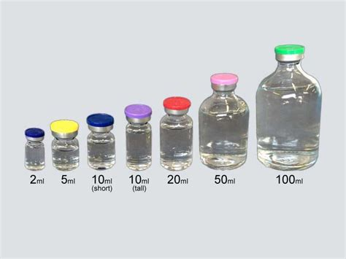
Dosage
Dosages will depend on each individual, as you will titrate (dose) up about every 2 weeks. The medication is administered once weekly, on the same day each week. Injections can be done at any time of the day, with or without meals. Avoid double dosing to prevent unwanted side effects. If a dose is missed, you can take the missed dose up to 5 days after you were originally supposed to take it. If more than 5 days have passed, skip the missed dose and return to your original dosing schedule.

Slide 10
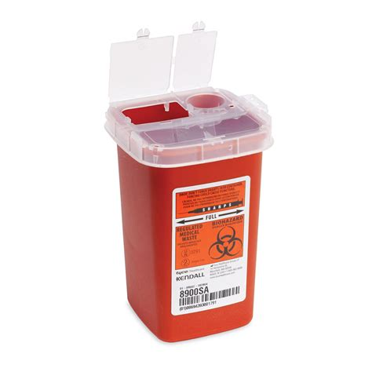
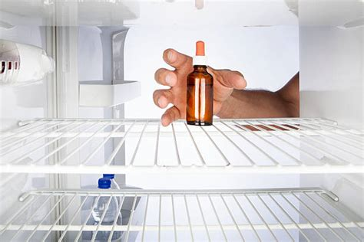
Storage
Keep semaglutide injections out of reach of children. Semaglutide will be dispensed by the pharmacy as a refrigerated liquid. Once you receive it, store in the refrigerator in between doses. Dispose of needles in a sharps containers available at your retail pharmacy, or, alternative, in a hard, closed container, such as a sealable detergent bottle.

Slide 11
Keep Seeing Your Provider
It is important that your doctor check your progress in regular visits, they be monthly or every 3-6 months. As you show positive progress, doctors visits will become less frequent. Let your doctor know if your medications, supplements, or vitamins change, as well as if you are or plan to become pregnant. To be safe, it is recommended that injections stop 2 months before pregnancy. Also, inform your trusted health care provider of any changes in physical or mental health.

Slide 12
Possible Side Effects
Loss of appetite
Light-headed or dizzy
Persistent lethargic feeling
Gastrointestinal discomfort
Diarrhea
Nausea or vomiting
Abdominal pain

